Slide 1
CAR Review
Team B:
Matthew Marotto, Rebeca Navarrete, Jim Kurtz

Slide 2
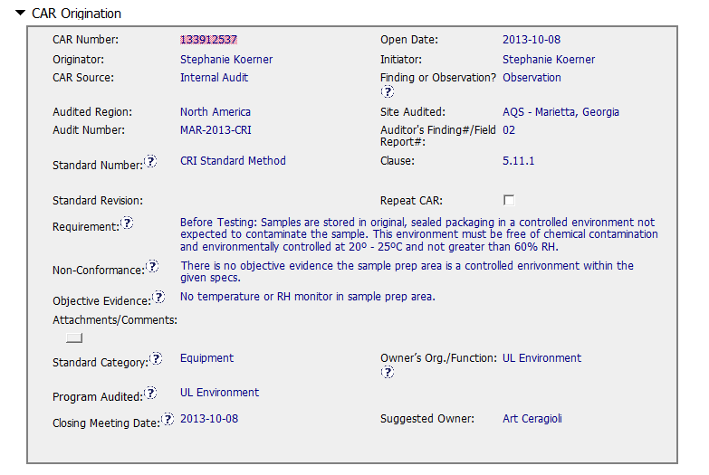
CAR 133912537
Could have been a finding, as trace back to prior test results should be considered.
Audit #?
Standard Revision ID Number missing?
Fields filled-out appropriately
Should be Accommodation, Facilities, Environmental conditions
Objective evidence should say no temperature or RH monitor in / for sample prep area. Equipment doesn’t have to be in for effective check. Observation only required the measuring equipment be provided so CAR could have been closed after the first milestone was accepted.

Slide 3
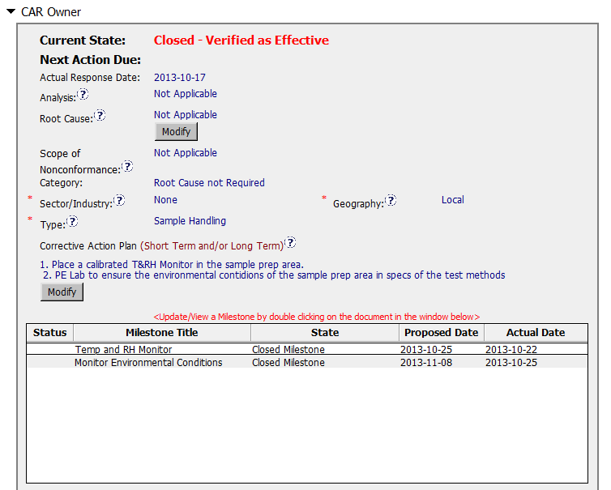
CAR 133912537
Correction Plan OK
Could be reduced to 1 milestone

